Slide 1
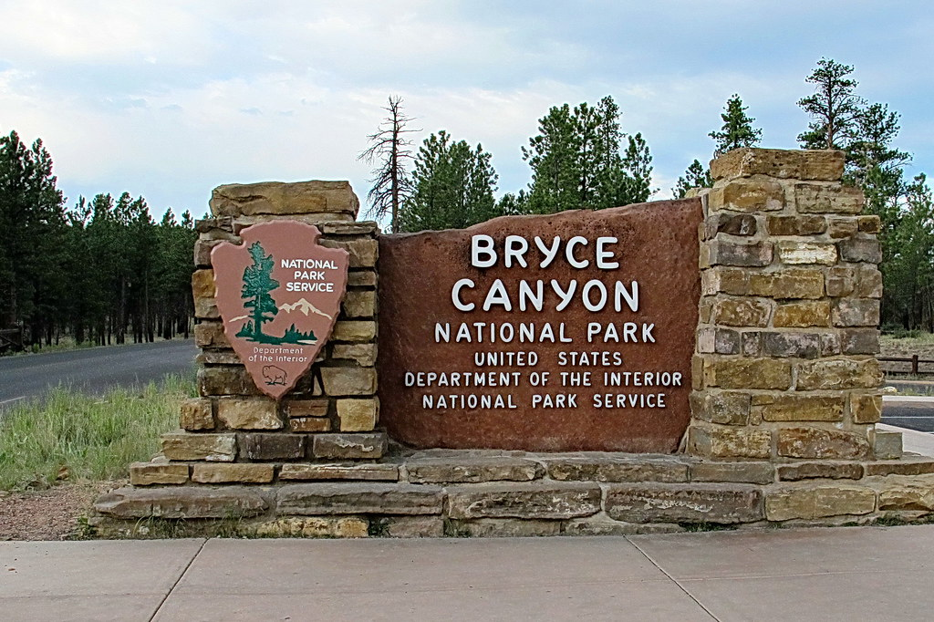
Intro
The Arrowhead: Emblem of the National Park Service
Have you ever wondered about that arrowhead you see on signs around your National Parks?
That’s the emblem of the National Park Service.

Slide 2
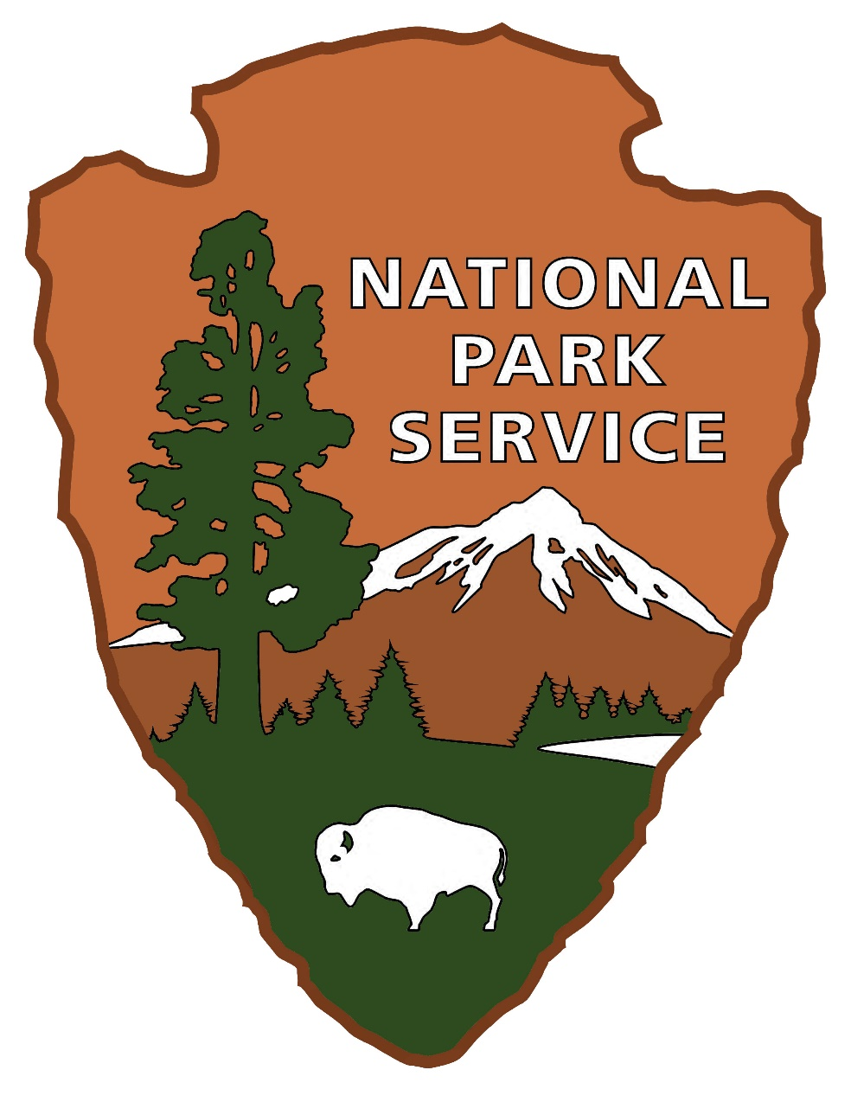
Symbols
The Arrowhead: Emblem of the National Park Service
Each picture found within the emblem symbolizes something the National Park Service (NPS) was created to protect.

Slide 3
Shape
The Arrowhead: Emblem of the National Park Service
The arrowhead shape represents historic and cultural values.

Slide 4
Culture
The Arrowhead: Emblem of the National Park Service
CULTURE: People have lived in the land today known as Bryce Canyon National Park for at least 10,000 years.
The people of Bryce past to present. Paiute Riders, Ebenezer and Mary Bryce, a Navajo rug weaver, J.W. Humphfrey and Paiute Tribe member Jeremy.

Slide 5
Timeline
The Arrowhead: Emblem of the National Park Service
10,000 years ago
Paleoindians

Slide 6
Timeline Continued 1
The Arrowhead: Emblem of the National Park Service
10,000 years ago
Paleoindians
________
Pueblo Peoples

Slide 7
Timeline Continued 2
The Arrowhead: Emblem of the National Park Service
10,000 years ago
Paleoindians
1200 AD
Paiute Indians
________
Pueblo Peoples

Slide 8
Timeline Continued 3
The Arrowhead: Emblem of the National Park Service
10,000 years ago
Paleoindians
1200 AD
Paiute Indians
________
Pueblo Peoples
1800’s
Later-day Saints Settlers

Slide 9
Timeline Continued 4
The Arrowhead: Emblem of the National Park Service
10,000 years ago
Paleoindians
1200 AD
Paiute Indians
Early 1900’s
U.S. Forest Service
________
Pueblo Peoples
1800’s
Later-day Saints Settlers

Slide 10
Timeline Continued 5
The Arrowhead: Emblem of the National Park Service
10,000 years ago
Paleoindians
1200 AD
Paiute Indians
Early 1900’s
U.S. Forest Service
________
Pueblo Peoples
1800’s
Later-day Saints Settlers
1922
Union Pacific Railroad

Slide 11
Timeline Continued 6
The Arrowhead: Emblem of the National Park Service
10,000 years ago
Paleoindians
1200 AD
Paiute Indians
Early 1900’s
U.S. Forest Service
1923
National Park Service
________
Pueblo Peoples
1800’s
Later-day Saints Settlers
1922
Union Pacific Railroad

Slide 12
Timeline Continued 7
The Arrowhead: Emblem of the National Park Service
10,000 years ago
Paleoindians
1200 AD
Paiute Indians
Early 1900’s
U.S. Forest Service
1923
National Park Service
________
Pueblo Peoples
1800’s
Later-day Saints Settlers
1922
Union Pacific Railroad
1934-1942
Civilian Conservation Corps

Slide 13
Timeline Continued 8
The Arrowhead: Emblem of the National Park Service
10,000 years ago
Paleoindians
1200 AD
Paiute Indians
Early 1900’s
U.S. Forest Service
1923
National Park Service
2018
2.5 million visitors
________
Pueblo Peoples
1800’s
Later-day Saints Settlers
1922
Union Pacific Railroad
1934-1942
Civilian Conservation Corps

Slide 14
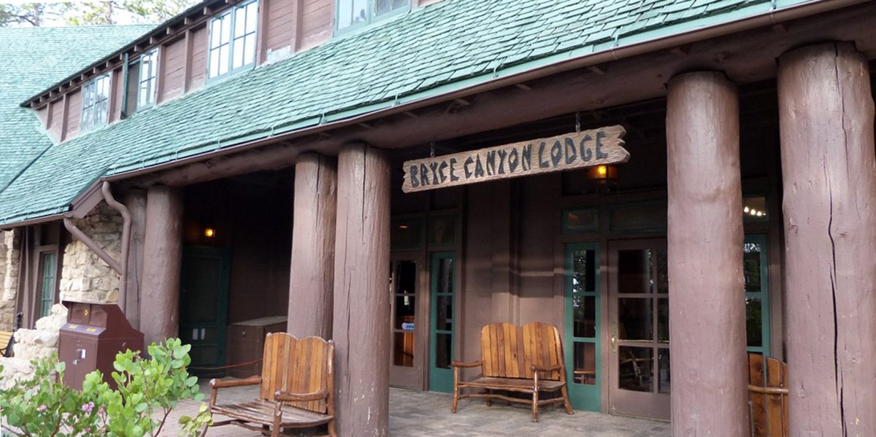
History
The Arrowhead: Emblem of the National Park Service
History is all around us.
The National Park Service is one of the United States' leading agencies for history and culture. In addition to preserving the stories of people who came before us, the NPS also protects important historic sites within national park boundaries.

Slide 15
Transition 1
The Arrowhead: Emblem of the National Park Service
Next up:

Slide 16
Transition: Mountain
The Arrowhead: Emblem of the National Park Service
Next up:
The Mountain

Slide 17
Mountain
The Arrowhead: Emblem of the National Park Service
The mountain represents land formations, scenery, and recreational opportunities.

Slide 18
Landforms
The Arrowhead: Emblem of the National Park Service
LANDFORMS: Bryce Canyon National Park is best known for its hoodoos (irregular columns of rock). While hoodoo formations exist on every continent, Bryce Canyon boasts the largest concentration found anywhere on Earth.
Plateau
Wall or Fin
Window
Hoodoo
From a plateau, eventually the rocks break down into walls, windows, and then as individual hoodoos.

Slide 19
Transition
The Arrowhead: Emblem of the National Park Service
Next up:

Slide 20
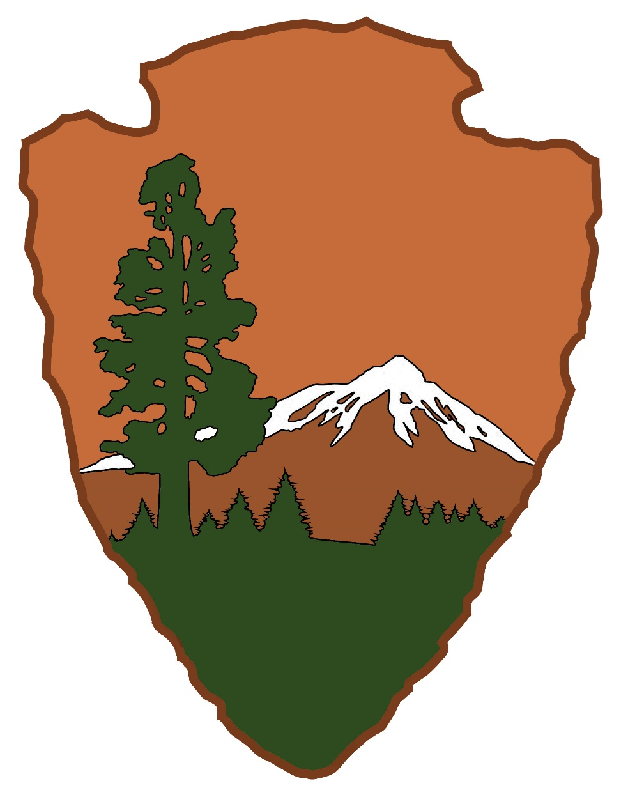
Transition Sequoia Tree
The Arrowhead: Emblem of the National Park Service
Next up:
The Sequoia Tree

Slide 21
Sequoia Tree
The Arrowhead: Emblem of the National Park Service
The Sequoia Tree represents vegetation.

Slide 22
Plants
The Arrowhead: Emblem of the National Park Service
Plants: Bryce Canyon is home to many plant communities. Surrounded by deserts, Bryce's highland plateau gets much more rain than the lowlands below and stays cooler during hot summers. The relatively lush ecosystems that result are like fertile islands towering above a vast arid landscape.
A special area of notice are the "breaks" of the amphitheater, better known as the pink cliffs, they are exposed, nearly unforested areas. Meadows, seeps, and springs are home to grassy and deciduous plant communities. Many of the meadows in the park are high and dry, home to sagebrush, rabbitbrush and grasses.
Wildflowers of Bryce Canyon National Park (left to right): Rabbit Brush, Paintbrush, Aster, Rabbit Brush gone to seed.

Slide 23
Transition 2
The Arrowhead: Emblem of the National Park Service
Next up:

Slide 24
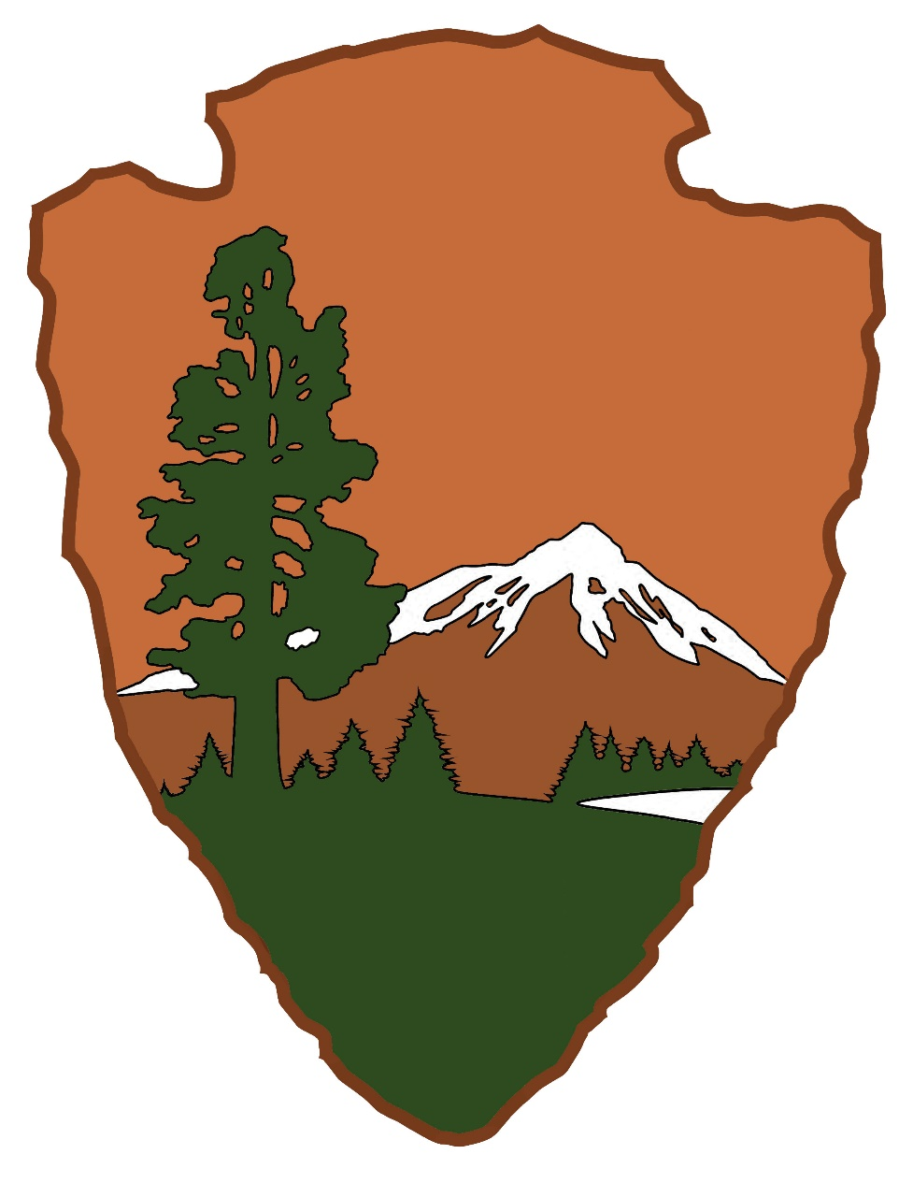
Transition Lake
The Arrowhead: Emblem of the National Park Service
Next up:
The Lake

Slide 25
Lake
The Arrowhead: Emblem of the National Park Service
The lake represents clean water and air.

Slide 26
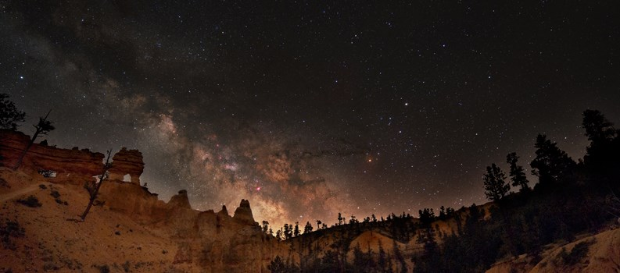
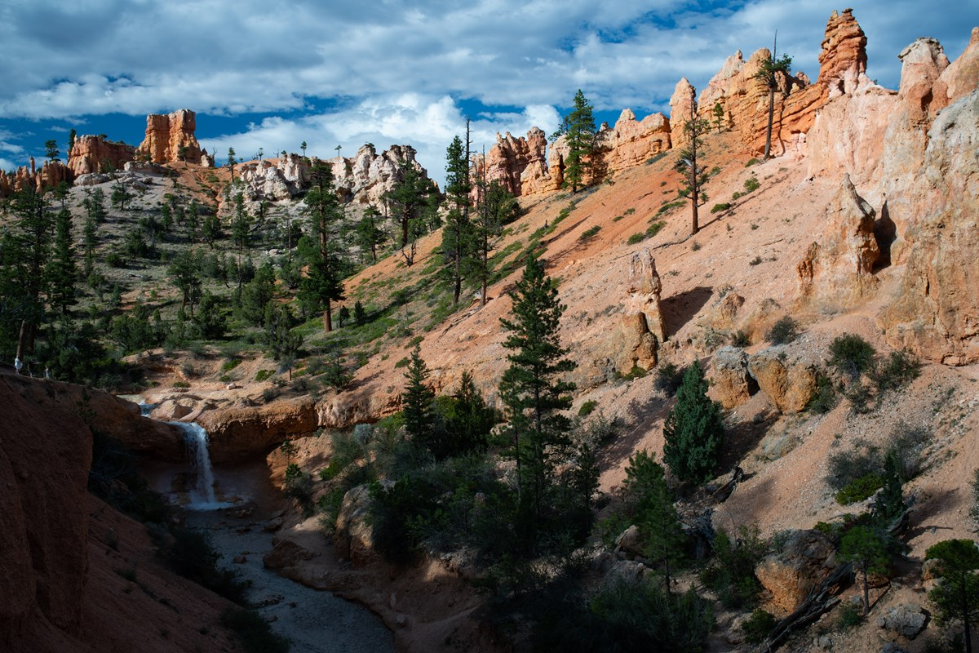
Water and Air
The Arrowhead: Emblem of the National Park Service
Water: Although we receive around 18 inches of precipitation (rain and snow) annually, there isn’t a lot of flowing water here in Bryce. Water is a special resource here because there is so much life that depends on it!
Air: Clean air and being far from the polluting lights of civilization allows for Bryce Canyon visitors to see an incredible night sky at the park.
Waterfall at Mossy Cave Trail
Milky Way Galaxy above hoodoos at Mossy Cave Trail.

Slide 27
Transition 3
The Arrowhead: Emblem of the National Park Service
Lastly:

Slide 28
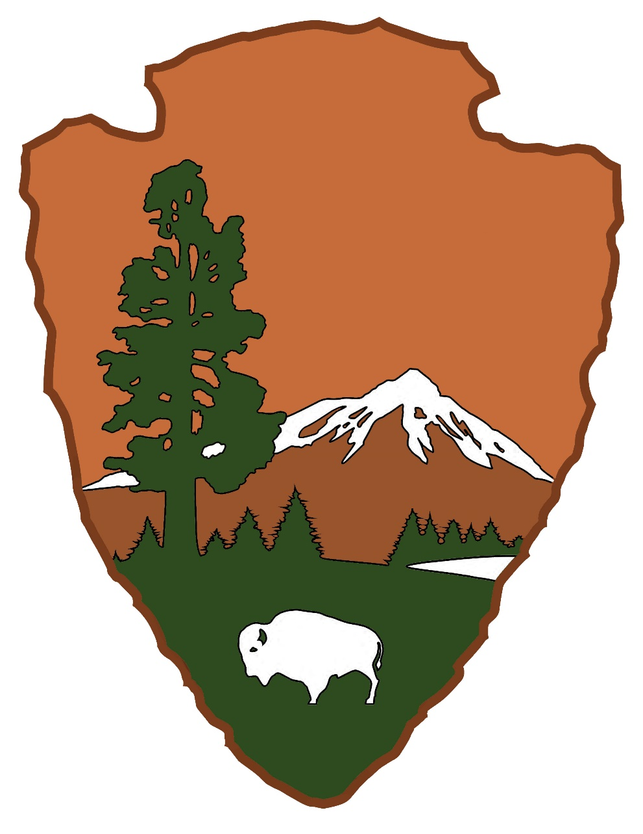
Transition Bison
The Arrowhead: Emblem of the National Park Service
Lastly:
The Bison

Slide 29
Bison
The Arrowhead: Emblem of the National Park Service
The bison represents all wildlife.

Slide 30
Animals and Endangered and Threatened Species
The Arrowhead: Emblem of the National Park Service
Animals: The canyons and plateau of Bryce Canyon National Park are home to many animals. Park boundaries mean little to the migratory hummingbirds, nesting Peregrine Falcon, Rocky Mountain Elk and Pronghorn which daily cross through the forested plateau and barren amphitheater.
Endangered and Threatened Species: The NPS works to sustain and recover at-risk species and help prevent extinction of plants and animals in the parks. In Bryce Canyon, the Utah Prairie Dog is a notable conservation success story as they have been downlisted from endangered to threatened.
Animals of Bryce Canyon National Park (left to right): Pronghorn Antelope, Black Bear, Chipmunk, Raven.

Slide 31
Represent
The Arrowhead: Emblem of the National Park Service
All these elements represent what National Parks were created to protect.

Slide 32
1916
The Arrowhead: Emblem of the National Park Service
Since 1916, the National Park Service has been entrusted with the care of our national parks.

Slide 33
NPS Mission
The Arrowhead: Emblem of the National Park Service
NPS Mission Statement: The National Park Service preserves unimpaired the natural and cultural resources and values of the National Park System for the enjoyment, education, and inspiration of this and future generations.

Slide 34
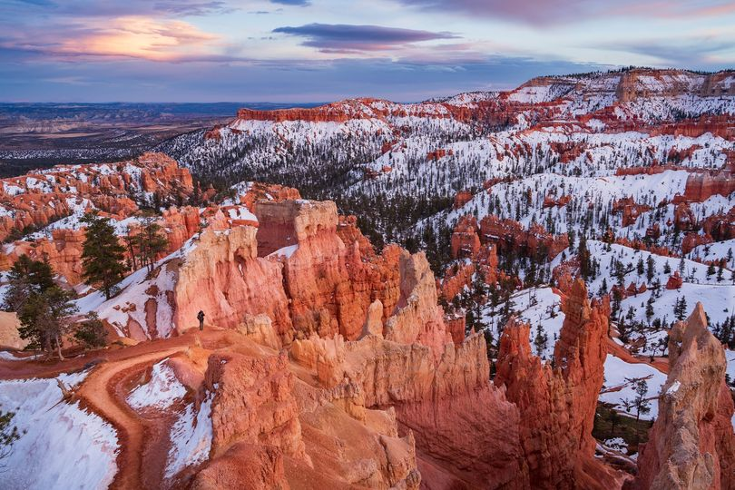
Picture of Bryce Canyon National Park
The Arrowhead: Emblem of the National Park Service

Slide 35
Quiz Intro
The Arrowhead: Emblem of the National Park Service
POP QUIZ!

Slide 36
Question One
The Arrowhead: Emblem of the National Park Service
Quiz Question 1:
Name all the elements of the NPS emblem:
1.
2.
3.
4.
5.

Slide 37
Transition Answers
The Arrowhead: Emblem of the National Park Service
Answers!

Slide 38
Answers 1
The Arrowhead: Emblem of the National Park Service
Answers to Quiz Question 1:
Name all the elements of the NPS emblem:
1.
2.
3.
4.
5.

Slide 39
Answers 2
The Arrowhead: Emblem of the National Park Service
Answers to Quiz Question 1:
Name all the elements of the NPS emblem:
1. Arrowhead Shape
2.
3.
4.
5.

Slide 40
Answers 3
The Arrowhead: Emblem of the National Park Service
Answers to Quiz Question 1:
Name all the elements of the NPS emblem:
1. Arrowhead Shape
2. Mountain
3.
4.
5.

Slide 41
Answers 4
The Arrowhead: Emblem of the National Park Service
Answers to Quiz Question 1:
Name all the elements of the NPS emblem:
1. Arrowhead Shape
2. Mountain
3. Sequoia Tree
4.
5.

Slide 42
Answers 5
The Arrowhead: Emblem of the National Park Service
Answers to Quiz Question 1:
Name all the elements of the NPS emblem:
1. Arrowhead Shape
2. Mountain
3. Sequoia Tree
4. Lake
5.

Slide 43
Answers 6
The Arrowhead: Emblem of the National Park Service
Answers to Quiz Question 1:
Name all the elements of the NPS emblem:
1. Arrowhead Shape
2. Mountain
3. Sequoia Tree
4. Lake
5. Bison

Slide 44
Answers 7
The Arrowhead: Emblem of the National Park Service
Answers to Quiz Question 1:
Name all the elements of the NPS emblem:
1. Arrowhead Shape
2. Mountain
3. Sequoia Tree
4. Lake
5. Bison

Slide 45
Quiz 2
The Arrowhead: Emblem of the National Park Service
Quiz Question 2

Slide 46
Question 2
The Arrowhead: Emblem of the National Park Service
Quiz Question 2:
Name what each symbol of NPS emblem represents:
1. (Arrowhead Shape)
2. (Mountain)
3. (Sequoia Tree)
4. (Lake)
5. (Bison)

Slide 47
Transition Answers 2
The Arrowhead: Emblem of the National Park Service
Answers!

Slide 48
Answers 8
The Arrowhead: Emblem of the National Park Service
Answers to Quiz Question 2:
Name what each symbol of NPS emblem represents:
1. (Arrowhead Shape)
2. (Mountain)
3. (Sequoia Tree)
4. (Lake)
5. (Bison)

Slide 49
Answers 9
The Arrowhead: Emblem of the National Park Service
Answers to Quiz Question 2:
Name what each symbol of NPS emblem represents:
1. (Arrowhead Shape) History and Culture
2. (Mountain)
3. (Sequoia Tree)
4. (Lake)
5. (Bison)

Slide 50
Answers 10
The Arrowhead: Emblem of the National Park Service
Answers to Quiz Question 2:
Name what each symbol of NPS emblem represents:
1. (Arrowhead Shape) History and Culture
2. (Mountain) Landforms and scenic and recreational values
3. (Sequoia Tree)
4. (Lake)
5. (Bison)

Slide 51
Answers 11
The Arrowhead: Emblem of the National Park Service
Answers to Quiz Question 2:
Name what each symbol of NPS emblem represents:
1. (Arrowhead Shape) History and Culture
2. (Mountain) Landforms and scenic and recreational values
3. (Sequoia Tree) Vegetation/plants
4. (Lake)
5. (Bison)

Slide 52
Answers 12
The Arrowhead: Emblem of the National Park Service
Answers to Quiz Question 2:
Name what each symbol of NPS emblem represents:
1. (Arrowhead Shape) History and Culture
2. (Mountain) Landforms and scenic and recreational values
3. (Sequoia Tree) Vegetation/plants
4. (Lake) Water and scenic and recreational values
5. (Bison)

Slide 53
Answers 13
The Arrowhead: Emblem of the National Park Service
Answers to Quiz Question 2:
Name what each symbol of NPS emblem represents:
1. (Arrowhead Shape) History and Culture
2. (Mountain) Landforms and scenic and recreational values
3. (Sequoia Tree) Vegetation/plants
4. (Lake) Water and scenic and recreational values
5. (Bison) Animals

Slide 54
Answers 14
The Arrowhead: Emblem of the National Park Service
Quiz Question 3

Slide 55
Answers 15
The Arrowhead: Emblem of the National Park Service
Quiz Question 3:
List three ways you can help the NPS care for the things found on the emblem:
1.
2.
3.

Slide 56
Thank You
The Arrowhead: Emblem of the National Park Service
Thank you for caring for our national parks!

Slide 57
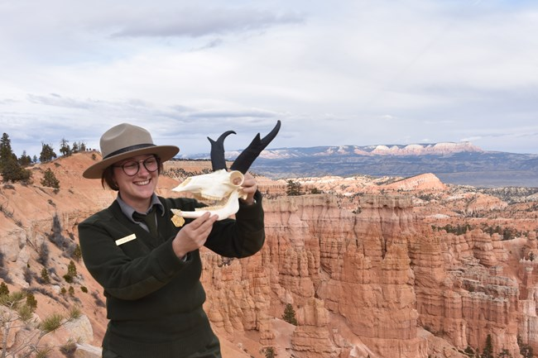
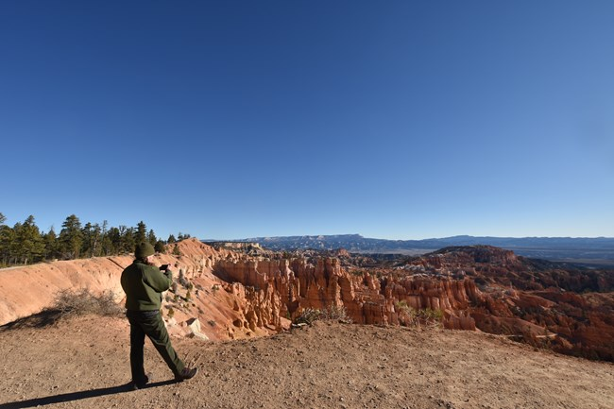
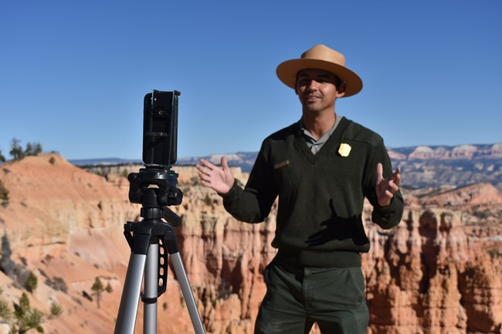
Contact Us
The Arrowhead: Emblem of the National Park Service
For more educational products and tools, please visit us at:
Education - Bryce Canyon National Park (U.S. National Park Service) (nps.gov)
To schedule a virtual experience please reach out to us at BRCA_education@nps.gov
Animal Adaptations
Geology of Bryce Canyon
Ask a Ranger

